Slide 1
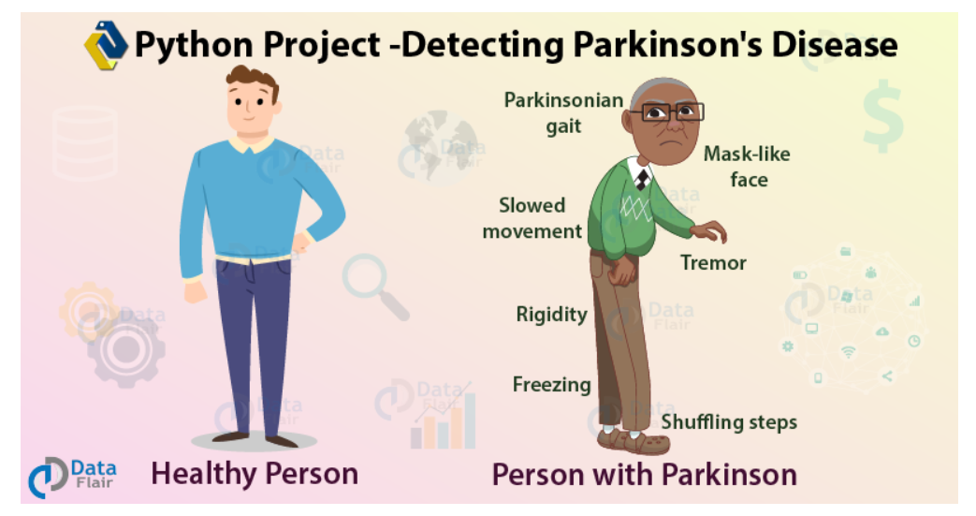
PARKINSON’S DISEASE PREDICTION
Done by:
Drishya Dinesh (RA1911003010311)
Siddharth Ojha (RA1911003010305)
Siddharth Anand (RA1911003010297)

Slide 2
INTRODUCTION
Parkinson’s Disease is a neurodegenerative, progressive disorder of the central nervous system that affects movement and causes tremors and stiffness.
This affects dopamine-producing neurons in the brain and every year, it affects more than 1 million individuals in India. This is chronic and has no cure yet.
In this data science project, we will detect Parkinson’s Disease with Python.
Diagnosis of Parkinson's disease (PD) is commonly based on medical observations and assessment of clinical signs, including the characterization of a variety of motor symptoms.
Early non-motor symptoms of PD may be mild and can be caused by many other conditions. Therefore, these symptoms are often overlooked, making diagnosis of PD at an early stage challenging.
To address these difficulties and to refine the diagnosis and assessment procedures of PD, we have implemented this project for the classification of PD
Objective: To build a model to accurately detect the presence of Parkinson’s disease in an individual.

Slide 3
TECHNOLOGIES USED TO BUILD THIS PROJECT
In this Python machine learning project, we use the Python libraries
Scikit-learn
Numpy
Pandas
Xgboost
Matplotlib
We will build a model using an XGBClassifier. We will load the data, get the features and labels, scale the features, then split the dataset, build an XGBClassifier, and then calculate the accuracy of our model.

Slide 4

XG BOOST
XGBoost is a new Machine Learning algorithm designed with speed and performance in mind. XGBoost stands for eXtreme Gradient Boosting and is based on decision trees. In this project, we will import the XGBClassifier from the xgboost library. It falls under the category of Ensemble Learning in ML, where we train and predict using many models to produce one superior output.

Slide 5

SCIKIT LEARN
Scikit-learn is a free software machine learning library for the Python programming language. It features various classification, regression and clustering algorithms including support-vector machines, random forests, gradient boosting, k-means and DBSCAN, and is designed to interoperate with the Python numerical and scientific libraries NumPy and SciPy.

Slide 6


PANDAS
Pandas is a software library written for the Python programming language for data manipulation and analysis. In particular, it offers data structures and operations for manipulating numerical tables and time series.

Slide 7

NUMPY
NumPy is a library for the Python programming language, adding support for large, multi-dimensional arrays, linear algebra, fourier transform and matrices, along with a large collection of high-level mathematical functions to operate on these arrays.

Slide 8
PREREQUISITES
We need to install the following libraries with pip
pip install numpy pandas sklearn xgboost
We also need to install Jupyter Lab or Jupyter Notebook, and then use the command prompt to run it

Slide 9
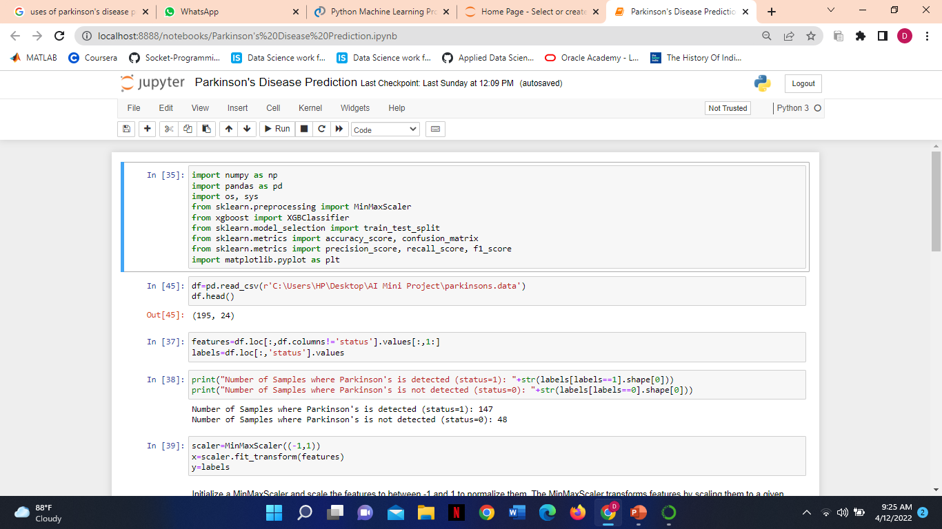
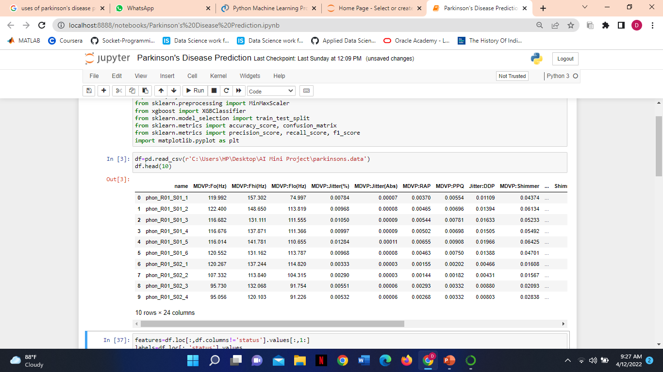
STEPS FOR DETECTING PARKINSON’S DISEASE
STEP 1- Make necessary imports
STEP 2- Now read the data into a DataFrame and get the first 10 records.

Slide 10
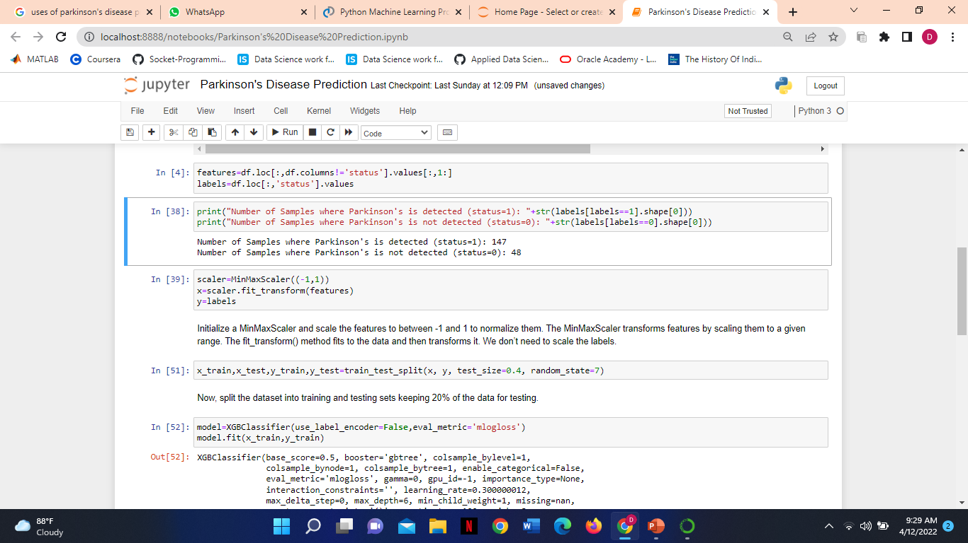
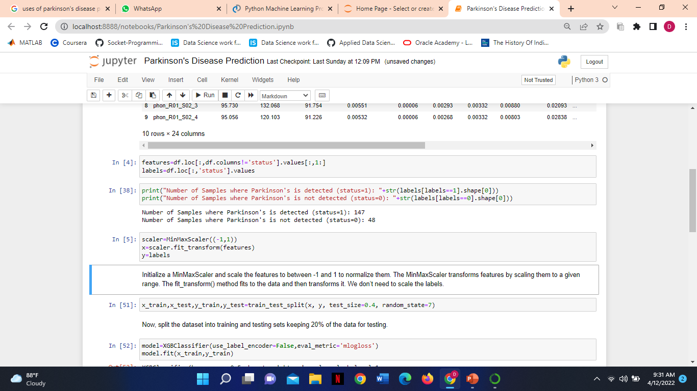
STEP 3- Get the features and labels from the DataFrame. The features are all the columns except ‘status’, and the labels are those in the ‘status’ column.
STEP 4- The ‘status’ column has values 0 and 1 as labels; let’s get the counts of these labels for both- 0 and 1.
STEP 5- Initialize a MinMaxScaler and scale the features to between -1 and 1 to normalize them. The MinMaxScaler transforms features by scaling them to a given range. The fit_transform() method fits to the data and then transforms it. We don’t need to scale the labels

Slide 11
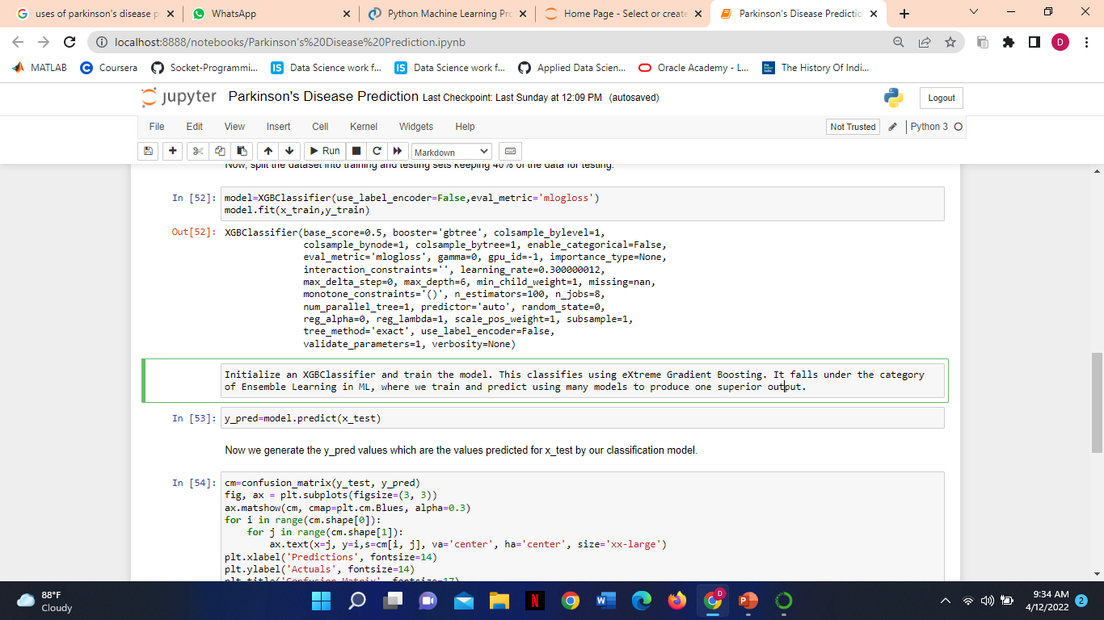
STEP 6- Now, split the dataset into training and testing sets keeping 40% of the data for testing.
STEP 7- Initialize an XGBClassifier and train the model. This classifies using eXtreme Gradient Boosting- using gradient boosting algorithms. It falls under the category of Ensemble Learning in ML, where we train and predict using many models to produce one superior output.

Slide 12
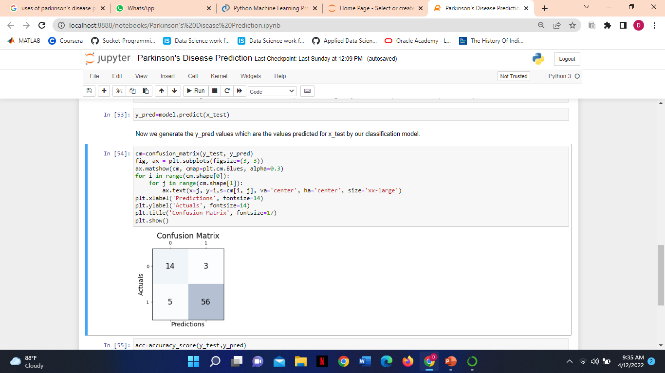
STEP 8- Finally we generate y_pred values which are the values predicted for x_test by our classification model.
STEP 9- We generate a confusion matrix to determine the number of samples classified correctly and the number of samples classified incorrectly.

Slide 13
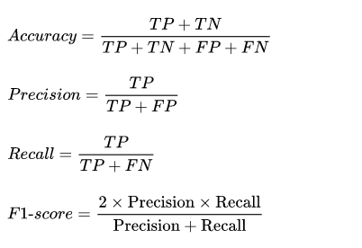
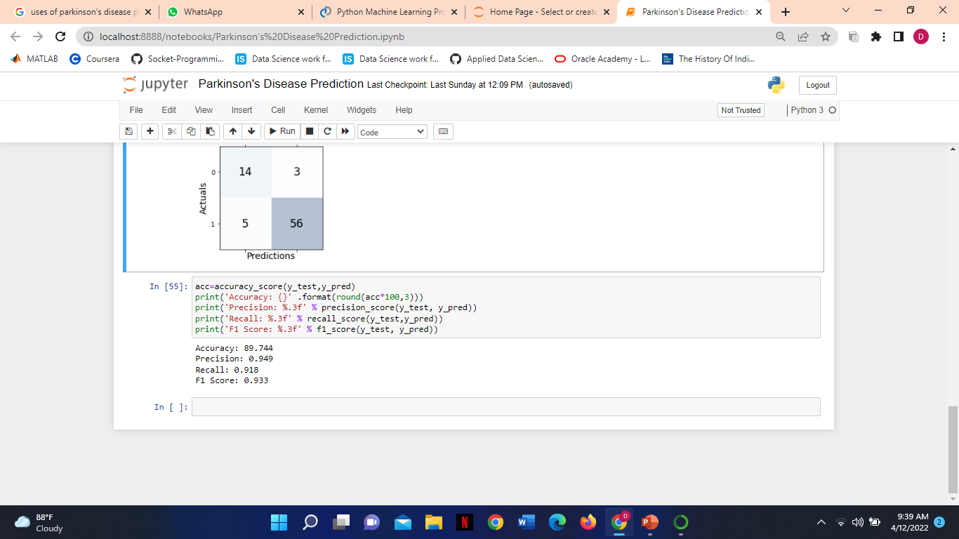
STEP 10- Finally we calculate the following parameters:
Accuracy: Number of samples correctly classified divided by total number of samples.
Precision: Number of true positives divided by the total number of positive predictions
Recall: Calculates the proportion of actual positives which were identified correctly
F1 score: F1 Score is the weighted average of Precision and Recall.

Slide 14
APPLICATION
PD is a very complex disorder in which individual motor features vary in their presence and severity over time. Early diagnosis of PD is essential.
The main challenge in the diagnosis of PD is the correct recognition of PD affected subjects in the early stages of the disease. Early diagnosis of PD can greatly affect the progression of the disease and the quality of life of the patient.
Therefore Parkinson’s Disease Prediction Model can be used to assist physicians in the diagnosis and prediction of the Parkinson’s disease.

